Slide 1

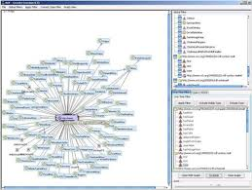

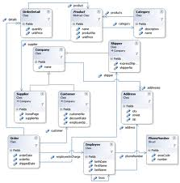
The MRM is an Ontology – a specification of shared concepts
Ontologies model
the real world.
Information describes
the real world.
Ontologies make
Information interoperable.
Data models
model information.

Slide 2
Ontology population procedure

